Slide 1
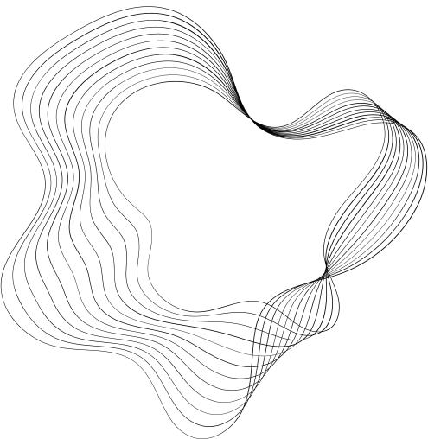

IMAGE CLASSIFICATION
LRA Benchmark
CIFAR - 10
By :
Agourram Sami
Oumaima Mouimi
Ayman Youss
Supervised By :
Pr.Hamza Alami
Pr.Issam Ait Yahia
1

Slide 2
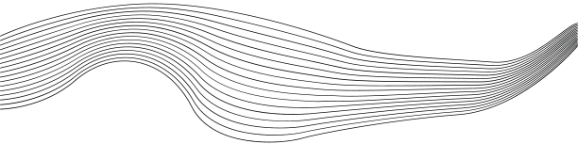
CONTENT
01
PROJECT OUTLINE
02
BENCHMARKING STRUCTURE
03
VIT OVERVIEW
04
BEIT OVERVIEW
05
RESULTS
2

Slide 3




PROJECT OUTLIINE
LRA (Long Range Arena) is a benchmark suite designed to evaluate the ability of models to handle long-range dependencies in various machine learning tasks.
Image Classification on Sequences of Pixels
Constraints :
Inputs are 1D pixel sequences.
No extra modules like CNNs allowed for preprocessing.
The model must infer 2D spatial relationships from the 1D sequence.
Restricted to CIFAR-10.
3

Slide 4

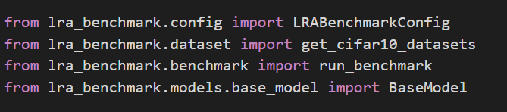


BENCHMARKING STRUCTURE
lra-benchmark package
4 main modules :
Dataset
Model
Benchmark Config
Benchmark
https://pypi.org/project/lra-benchmark/
4

Slide 5
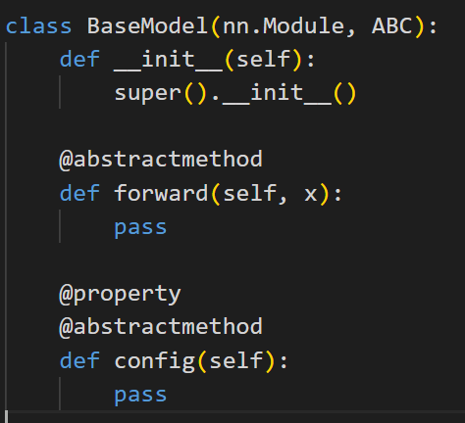
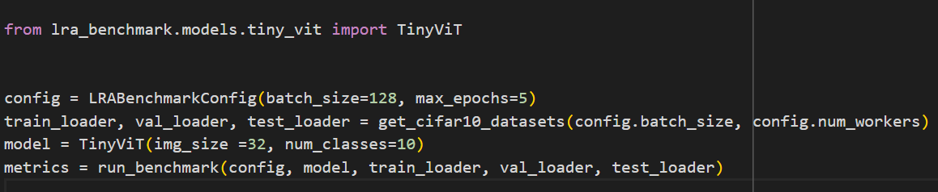
Building a Model
Benchmarking a Model
5

Slide 6
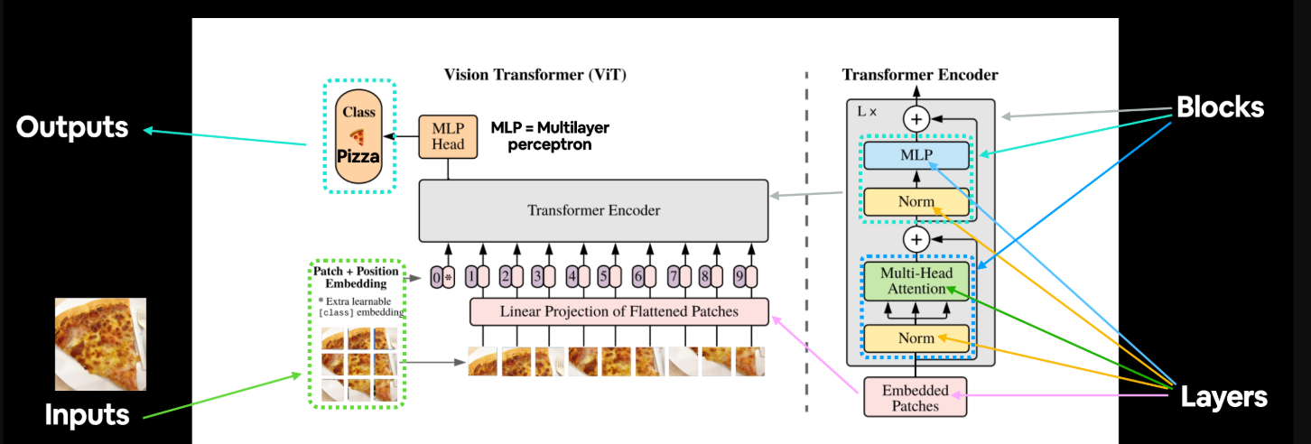
ViT Overview
An Image is Worth 16x16 Words*
*Initial ViT paper title
6

Slide 7

Motivation behind BEit
Transformer Success in Computer Vision but ViTs face a data-hungry challenge, where they struggle without sufficient training data.
Self-supervised pre-training emerges as a potential solution to leverage large-scale image data without needing extensive labeled datasets.
What is Self-supervised pre-training??
7

Slide 8
Self-supervised pre-training
Self-supervised pretraining is a type of machine learning approach where a model is pretrained on unlabeled data by creating its own supervision signal from the data itself. Instead of relying on manually labeled data, the model learns to predict or reconstruct parts of the data from the rest of it.
Masking is a technique used in self-supervised learning :
Parts of the input are “Masked” during training
The model is tasked with predicting or reconstructing the hidden parts
Purpose: The idea behind masking is to force the model to learn useful representations from the available context and generalize the missing parts.
8

Slide 9
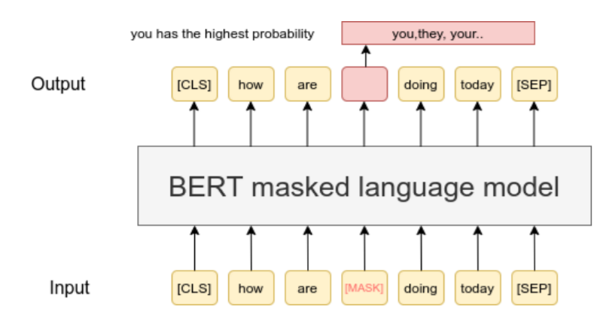
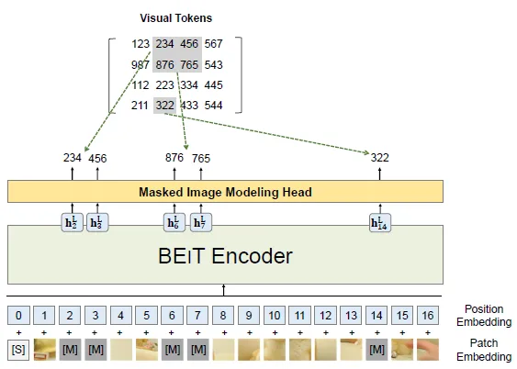

From NLP to Vision: Inspiration from BERT
Learns contextual relationships between words in text
Learns spatial relationships between patches in images.
9

Slide 10
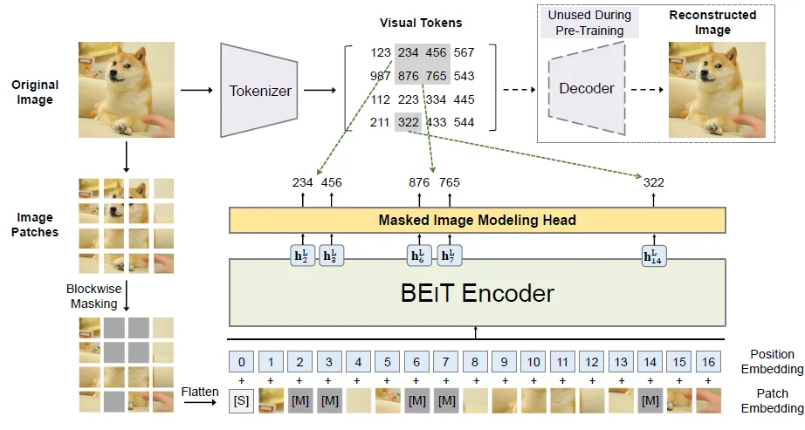
BEiT Architecture during pre-training
10

Slide 11
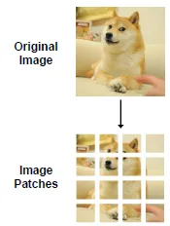
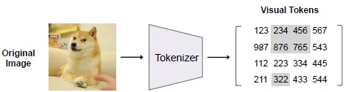
BEiT Architecture during pre-training
Image Representation
The tokenizer maps image patches to discrete visual tokens using a visual codebook (learned via dVAE)
Similar to ViT
11

Slide 12
BEiT Architecture during pre-training
Blockwise Masking
Approximately 40% image patches are randomly masked.
12

Slide 13
BEiT Architecture during pre-training
Masked Image Modeling (MIM) Task
BEiT encoder learns to predict the correct visual token IDs of the masked patches by leveraging the context from the unmasked patches.
The loss is calculated as the cross-entropy loss between the model’s predictions and the ground truth visual tokens.
Self attention mechanism
13

Slide 14
BEiT fine-tuning to downstream tasks
The decoder outputs hidden vector for each patch.
passing through MIM head = > tokens
Linear Layer to map the output to the output space of the task
The input image is divided into patches, as in pretraining.
These patches are embedded and passed through the BEiT encoder (which uses the learned visual tokens from pretraining).
cross-entropy loss function is used to compare the predicted class with the ground truth.
PREDICTION
INPUT IMAGE
PATCH EMBEDDING
LOSS FUNCTION
14

Slide 15
Focuses on using the learned representations
from pretraining for a specific task
The model receives full image patches and
directly applies the pretrained encoder to
generate predictions for the task.
The model begins with the pretrained weights.
(if pretrained = True)
Tokenizer is no longer used
Key differences
Focuses on learning representations without labels (using masked image modeling)
The Image is Block-wise masked to force the model to learn spacial relationship between the patches.
During pretraining, the model starts with randomly initialized weights.
Tokenizer is used to map each patch to a discrete token .
15

Slide 16



Configuration :
epochs : 15
Three versions of each model
patch_size = 1 (single pixel)
Pretrained = False
batch_size = 64
RESULTS
16

Slide 17

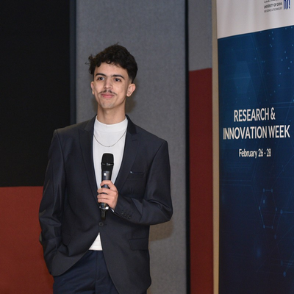
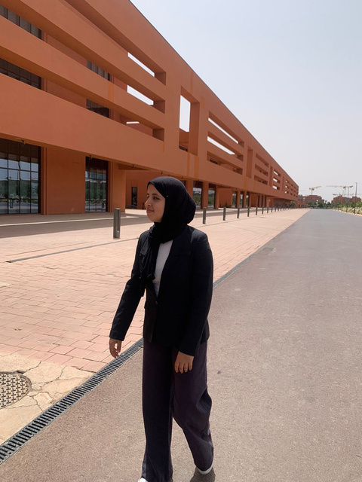
OUR TEAM
Ayman
Youss
Sami agourram
Oumaima
Mouimi
17

